Slide 1

Cyclistic
BIKE SHARE RIDERSHIP ANALYSIS
Dhanushwr K
Junior Data Analyst
28 July 2024

Slide 2
AGENDA
Objective
Membership analysis
Ride duration analysis
Roundtrip analysis
Bike type analysis
Annual bike ridership analysis
Weekly bike ridership analysis
Hourly bike ridership analysis
Departure hotspots analysis
Final insights
Marketing strategies

Slide 3

OBJECTIVE
Identify behavioral disparities between casual and annual Cyclistic members to inform a targeted marketing strategy aimed at member acquisition and retention from existing casual riders.

Slide 4
How do annual members and casual riders use Cyclistic bikes differently?

Slide 5
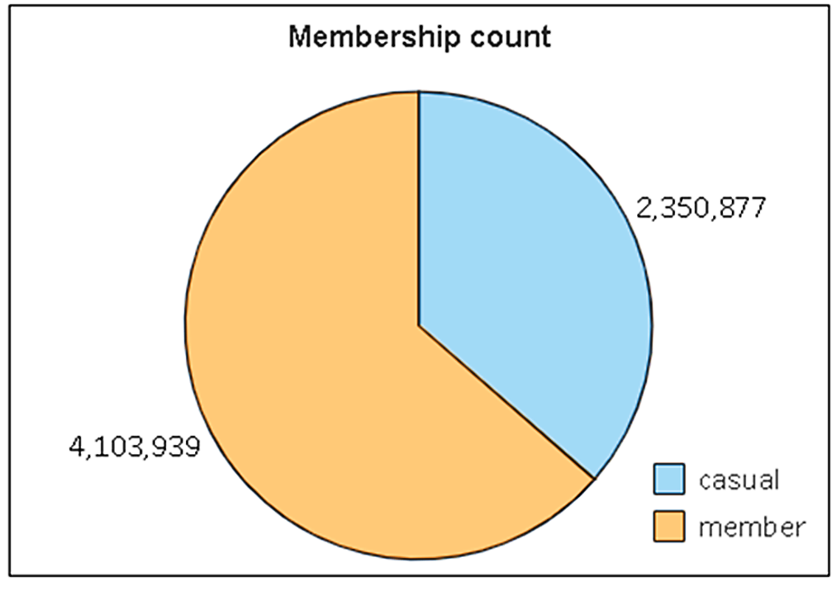
MEMBERSHIP ANALYSIS
Casual riders comprise the remaining 36.4%
Members account for 63.6% of Cyclistic’s customer base
Cyclistic's customer base is divided into two primary segments

Slide 6
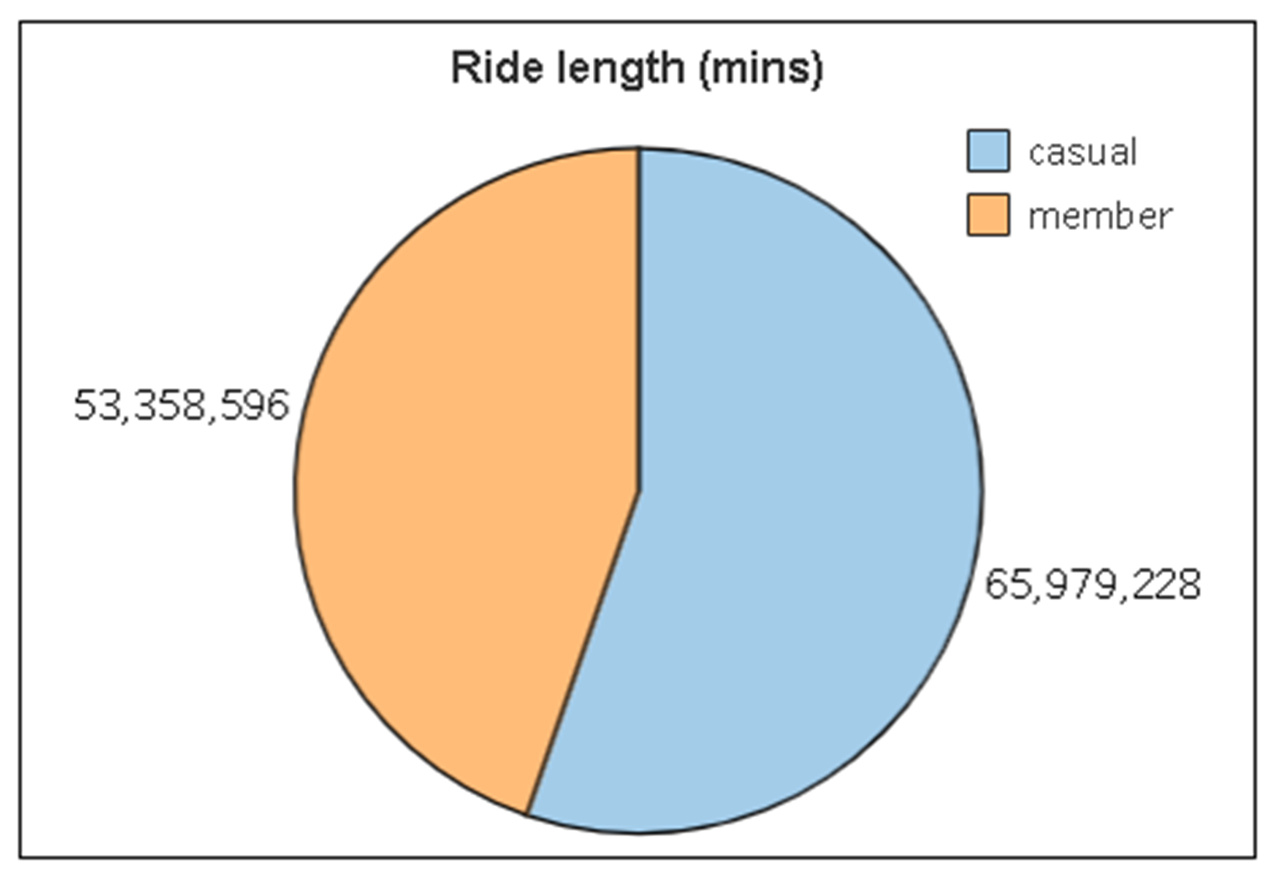
RIDE DURATION ANALYSIS
Members account for
53 million minutes approx.
Casual riders
logged approx.
65 million mins
Despite a larger customer base,
casual riders logged significantly more total ride time than members

Slide 7
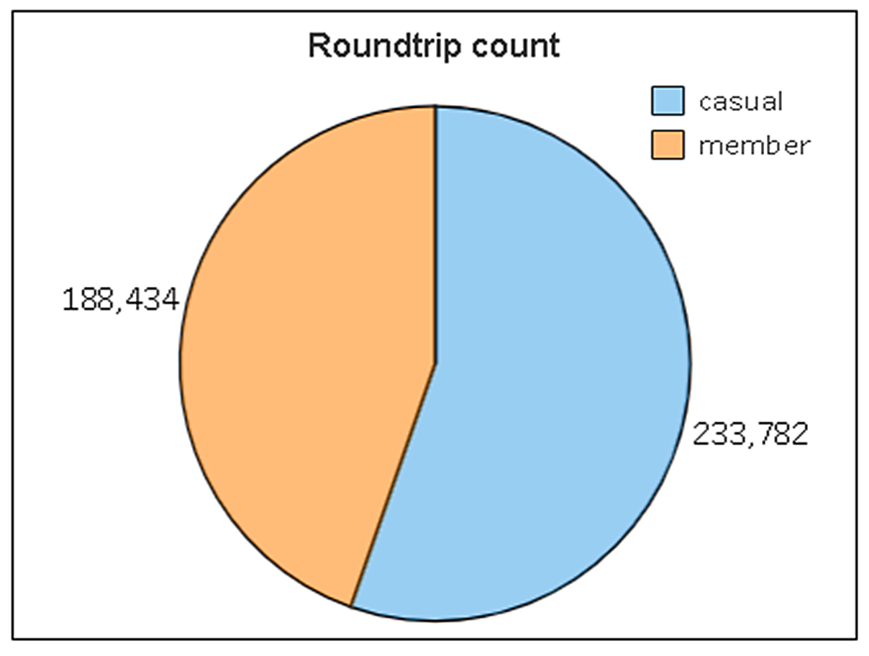
ROUNDTRIP ANALYSIS
Members
completed roughly around
18.8 million trips
Casual riders
took
23.3 million trips approx.
Despite a larger customer base,
casual riders surpasses member round trips by 10.8%.

Slide 8
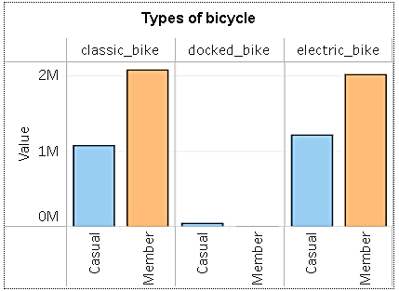
BIKETYPE ANALYSIS
A clear preference for electric and classic bikes
among both member and casual riders

Slide 9
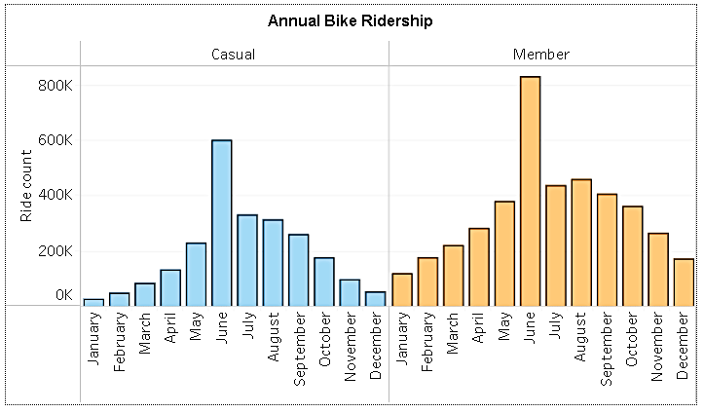
ANNUAL BIKE RIDERSHIP ANALYSIS
Peak usage occurring during the warmer months (April to October)
Significant decline during the
colder months (November to March).
Both casual and member ridership
exhibit a pronounced seasonal pattern.

Slide 10
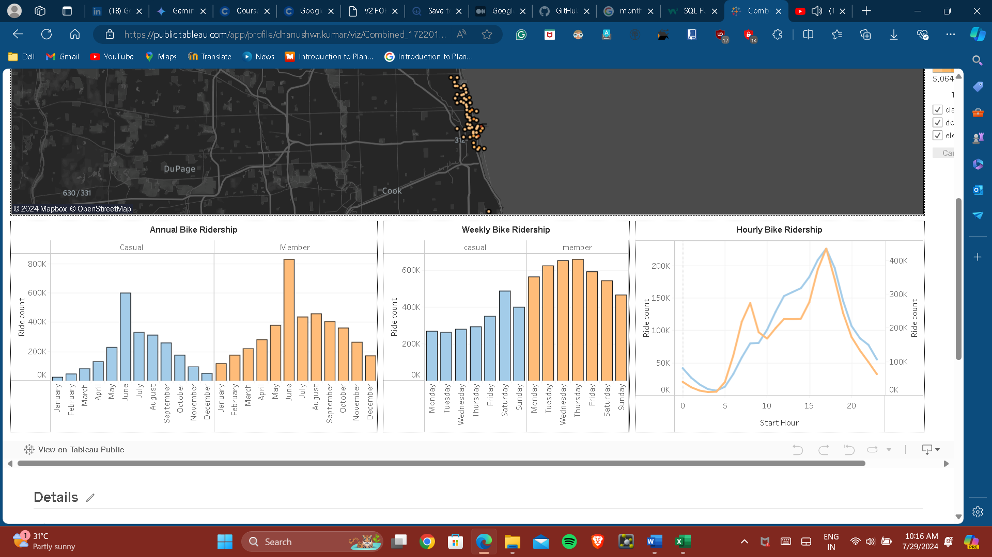
WEEKLY BIKE RIDERSHIP ANALYSIS
Casual riders demonstrate a pronounced preference for weekend usage (Saturday and Sunday).
Members exhibit higher ridership on weekdays (Monday to Friday) compared to weekends.
Complementary usage patterns
between the two customer segments

Slide 11
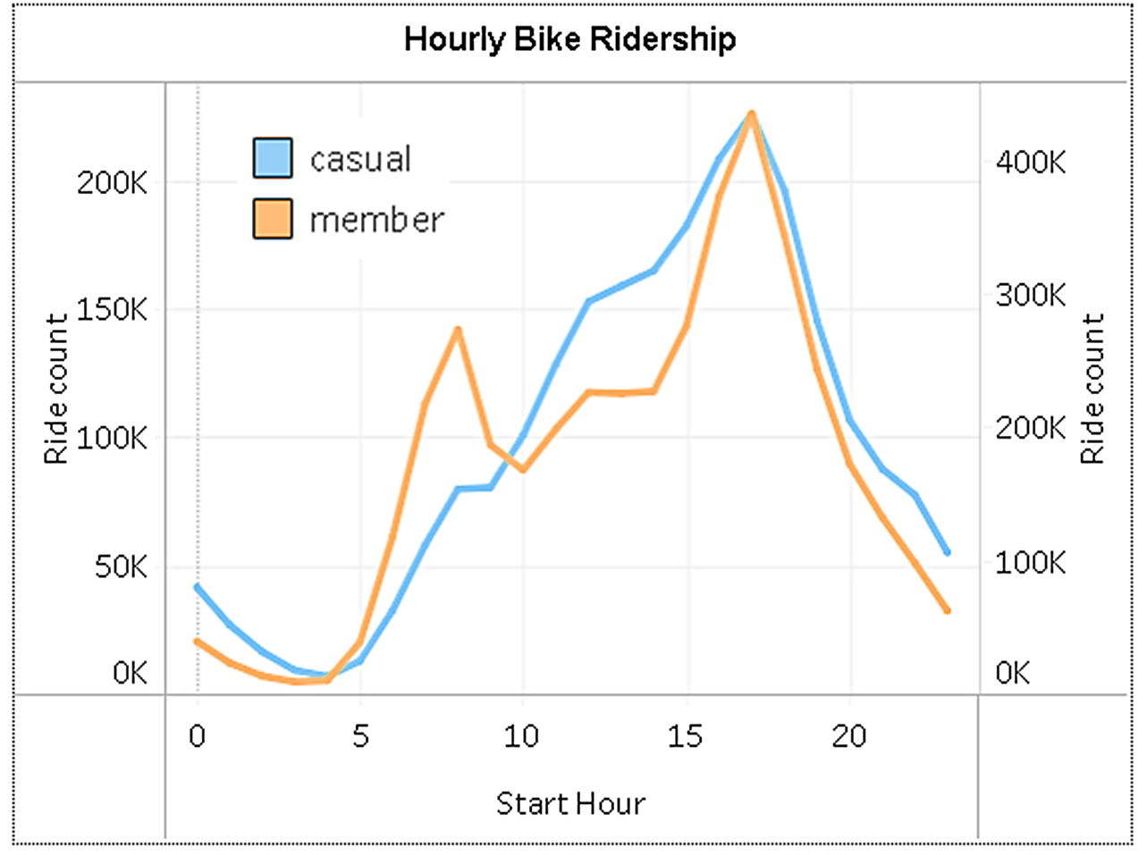
HOURLY BIKE RIDERSHIP ANALYSIS
Between 6 AM and 9 AM, ridership increases significantly for both groups
Between 4 PM and 7 PM, both groups experience another peak
Casual riders tend to have a more pronounced evening peak compared to members.
Members exhibit a more pronounced peak during this period.

Slide 12
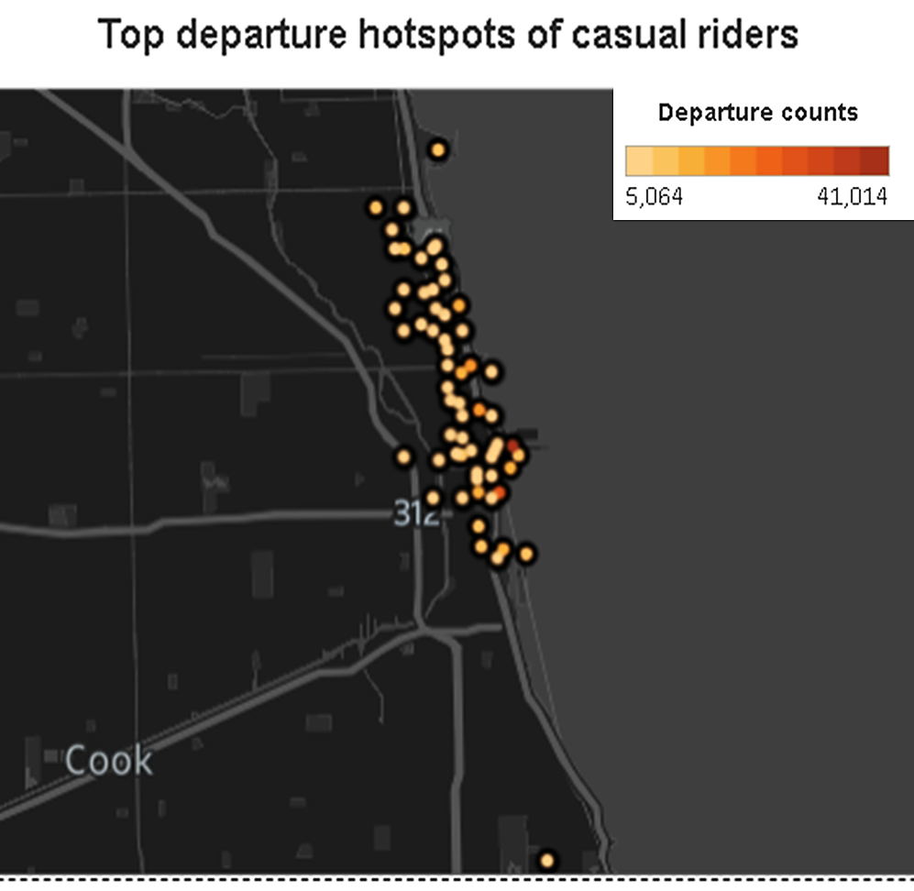
DEPARTURE HOTSPOTS ANALYSIS
Distinct clusters of
high-departure locations
These clusters likely correspond to areas with high population density, employment centres, or popular recreational destinations.

Slide 13
Key differences

Slide 14
FINAL INSIGHTS
Customer
Bike
profile
preferences
Casual riders represent 36.4% of the customer base.
Members, constitutes
about 63.6% of the customer base
Both segments favour electric and classic bikes, with a slight inclination towards classic bikes for members.
Docked bikes are predominantly used by casual riders.
Ride
Departure
behavior
hotspots
Casual riders exhibit higher ride frequency and longer durations.
Members display lower ride frequency but longer individual rides.
High-departure locations offer opportunities for targeted marketing to casual riders.

Slide 15
Marketing strategies

Slide 16
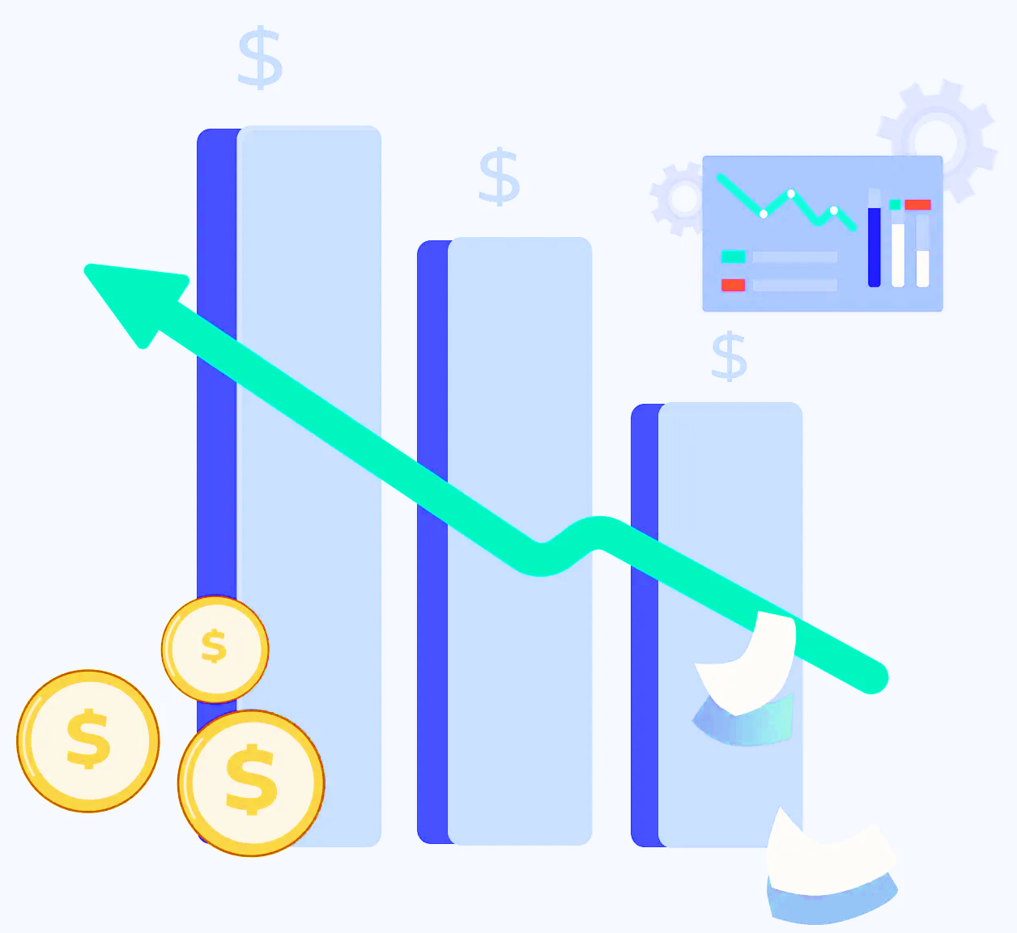


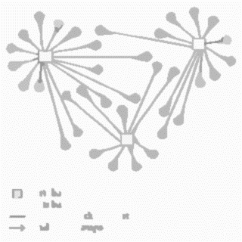
MARKETING STRATEGIES
Dynamic
Optimize
Membership
Innovating
Pricing
Bike distribution
Benefits
App functionality
Implement membership fees are lower during off-peak hours and higher during peak hours.
Align bike distribution with seasonal and daily usage patterns to ensure availability during peak periods.
Advantages of membership, such as cost savings, exclusive access, and convenience.
Offer additional perks for longer memberships, such as bike accessories, priority bike access, or exclusive events.
Develop features that make it easier for casual users to transition to members, such as one-click upgrades or personalized recommendations.

Slide 17
Thank you!
Dhanushwr K
Junior Data Analyst
28 July 2024

